Slide 1





A guide to experimental art practice for young people

Slide 2


You will find five lots of activities which will make you think about and make art in different ways. You can do these on your own, but we really encourage you to try things out with other people, friends, classmates, teachers and family. Working together can be fun and you can often make and discover things that you could never have done on your own.
You can do the activities in any order you choose. You might want to do some of them more than once to see how different your responses can be. The important thing to remember is that this is about you trying out new things and making art in new ways.
The idea is not to produce finished works of art. It’s about the process and what it means to you, how it makes you feel,and what ideas it makes you think of. Take your time with these things and enjoy it.
Sometimes it is when you are not thinking too hard that the most interesting things happen.

Slide 3

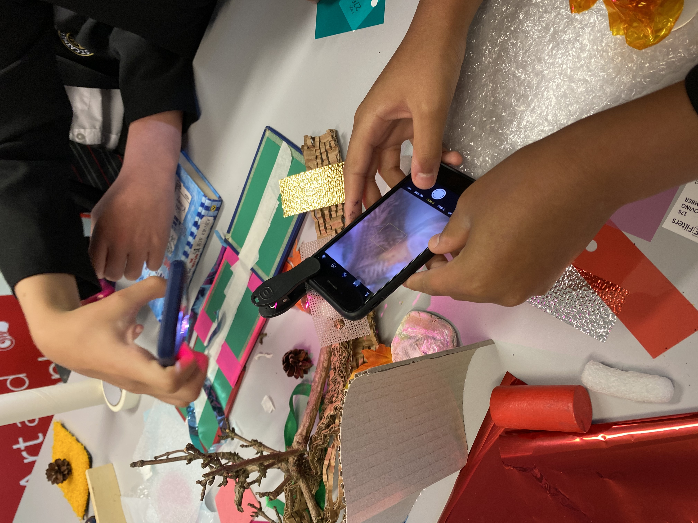
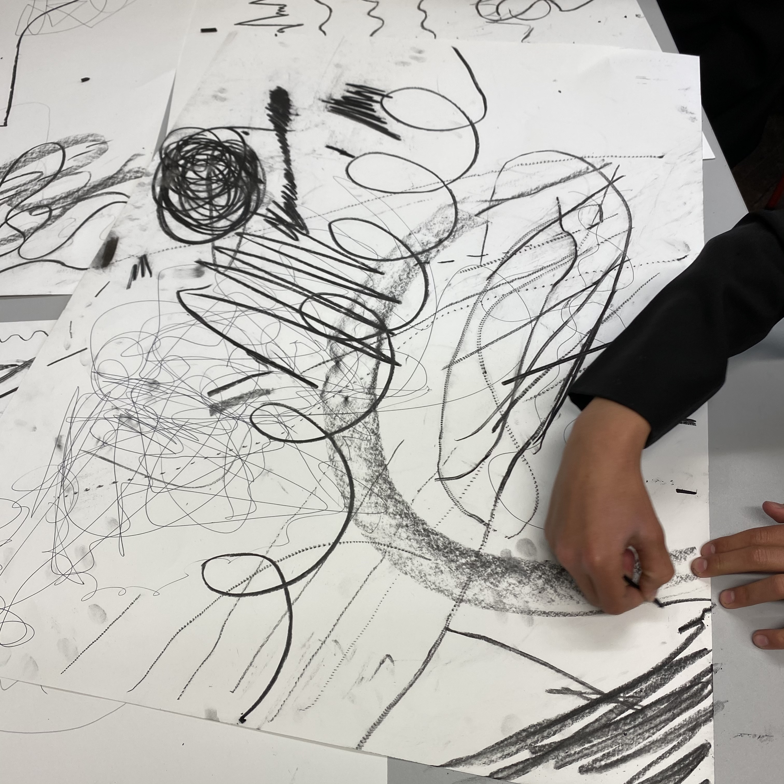
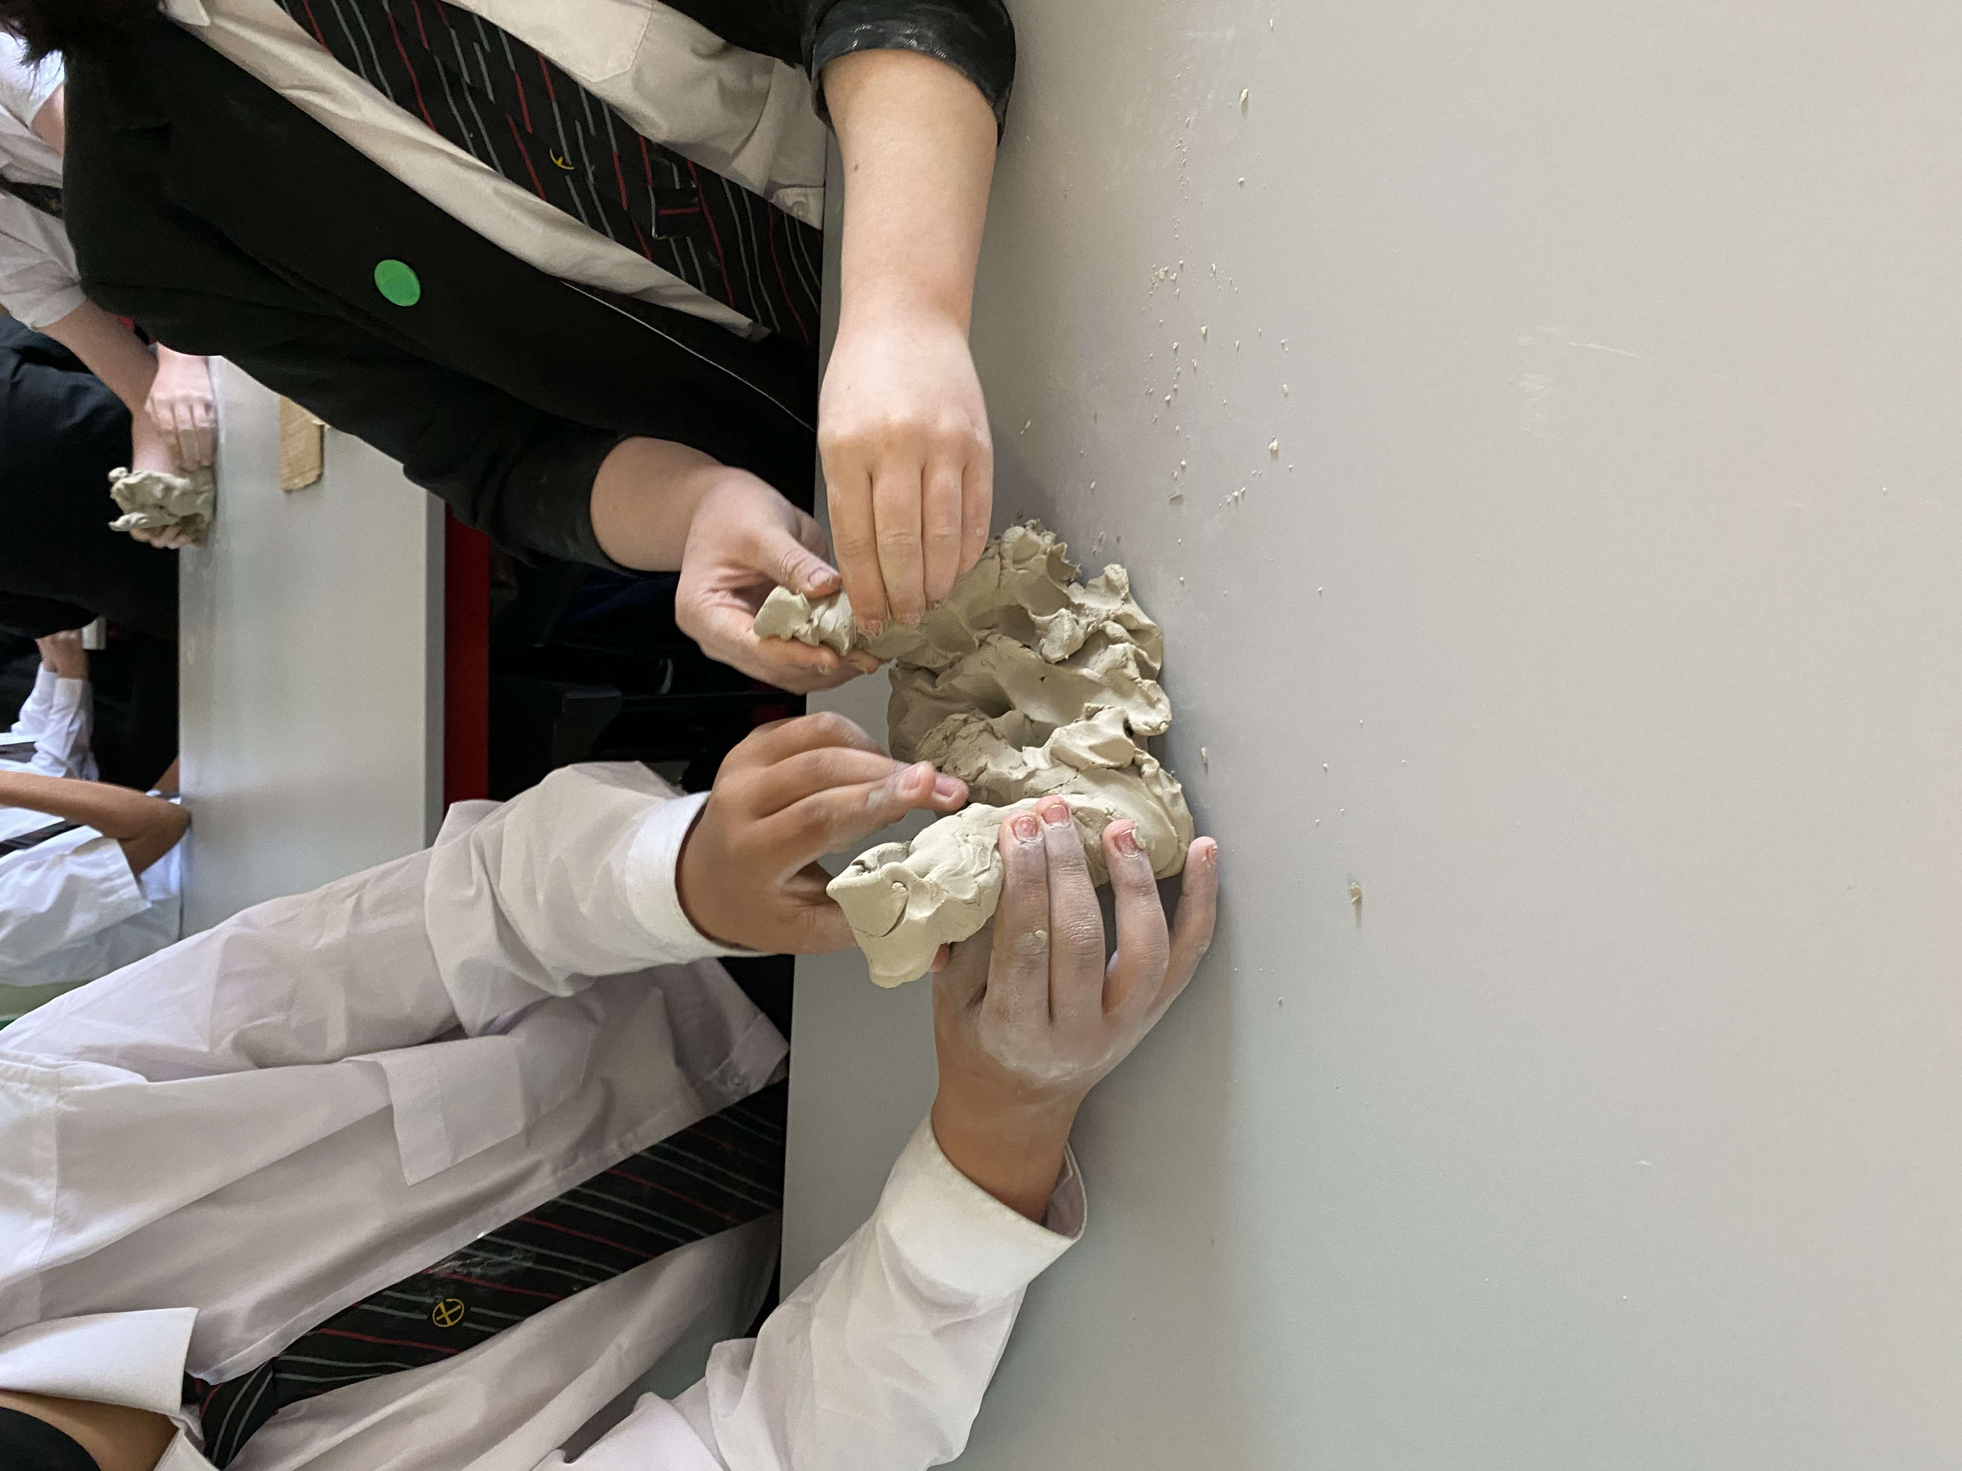
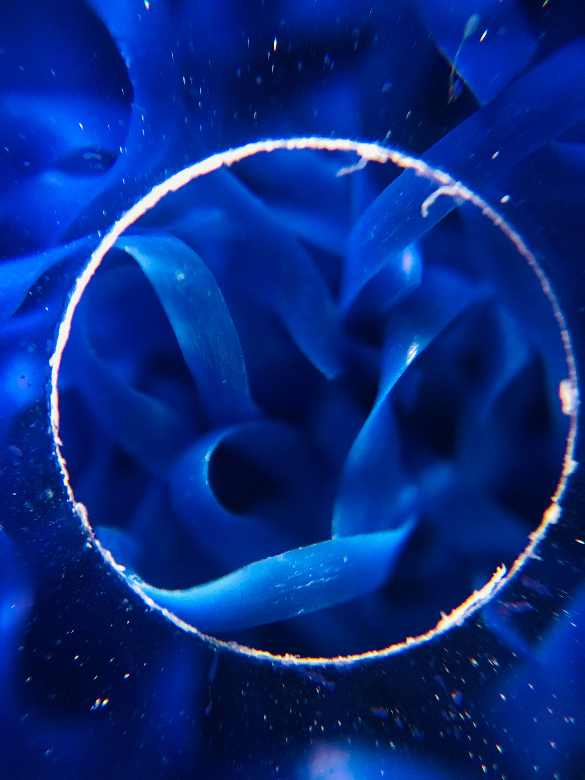

Slide 4
SAMPLE TITLE
SAMPLE SUBHEADING
You will find five lots of activities which will make you think about and make art in different ways. You can do these on your own, but we really encourage you to try things out with other people, friends, classmates, teachers and family. Working together can be fun and you can often make and discover things that you could never have done on your own.
You will find five lots of activities which will make you think about and make art in different ways. You can do these on your own, but we really encourage you to try things out with other people, friends, classmates, teachers and family. Working together can be fun and you can often make and discover things that you could never have done on your own.

Slide 5


SAMPLE TITLE
SAMPLE SUBHEADING
Sample bullet point
Sample bullet point
Sample bullet point
Sample bullet point
Sample bullet point

Slide 6


SAMPLE TITLE
SAMPLE SUBHEADING
You will find five lots of activities which will make you think about and make art in different ways. You can do these on your own, but we really encourage you to try things out with other people, friends, classmates, teachers and family. Working together can be fun and you can often make and discover things that you could never have done on your own.

Slide 7

A guide to experimental art practice for young people

